Slide 1
Outline
Case Study 1: Find fitting parameters for NCOR for normal impact
Case Study 2: Use wall NCOR correlations for oblique impact

Slide 2
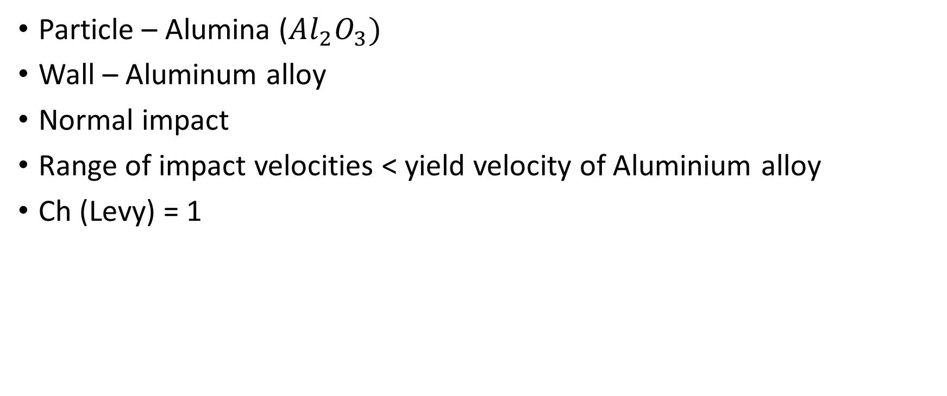
Fitting parameter for NCOR – a case study
Particle – Alumina ($Al_{2}O_{3})$
Wall – Aluminum alloy
Normal impact
Range of impact velocities < yield velocity of Aluminium alloy
Ch (Levy) = 1

Slide 3
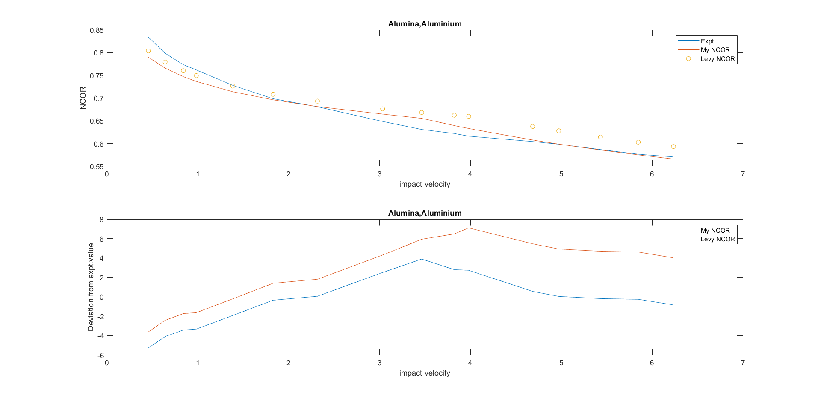
Results
Levy’s Ch =1
Fitted Ch = 0.8266

Slide 4
Using the wall NCOR correlation for other materials – a case study
Particle – Hardened steel ball
Material properties of hardened steel not available, so mild steel is used
Wall – 301 SS
Oblique impact – four impact angles considered
Range of impact velocities above and below yield velocity
Only Ch (Levy) = 66 used, no fitting of parameters

Slide 5
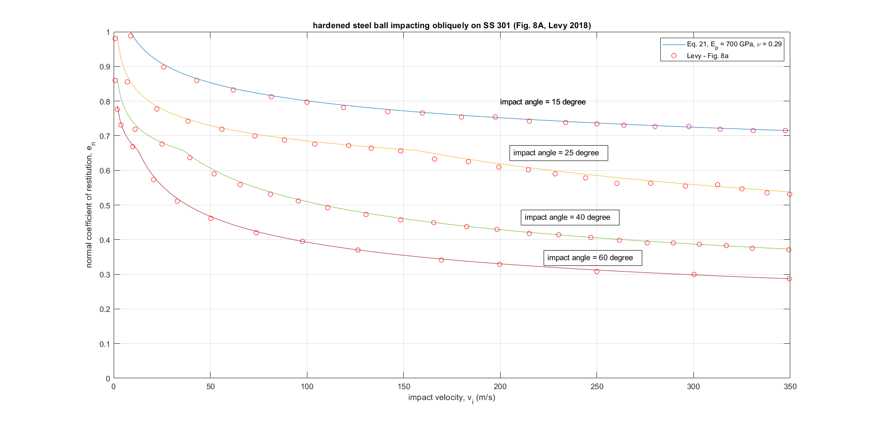
Results

